Slide 1
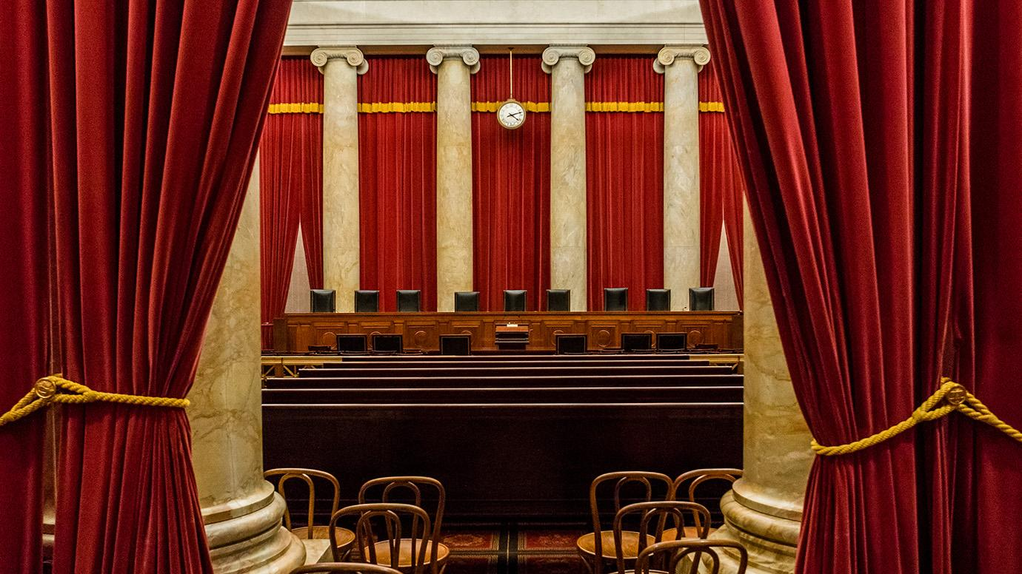
Model Rulings of the United States Supreme Court
Mirella Mardakis, Erica Leon, Emily Tavik

Slide 2
Oyez.
Oyez.
Oyez.

Slide 3
Objectives
Collect data regarding on individual Supreme Court Justice votes
Supreme Court Database (via Washington University Law)
Create a model based on the most recent 8 Justices to understand and predict how each would vote based on the input data
Term
Precedent Alteration
Issue Area
Law Type
Case State Origin

Slide 4
Tools Used
Sci-Kit Learn
Pandas
Tableau
HTML/Bootstrap
_________________________________

Slide 5
Mitigating Factors in Ruling Analysis
Justices vote each year on which of the thousands of cases brought before them to hear. Cases need a 4/9 vote to be heard.
Often, denying to hear a case implies siding with the lower Court’s ruling.
Theories of Constitutional Interpretation
Originalism
Textualism
Non-Originalist (Living Constitutionalism)
Precedent Alterations

Slide 6
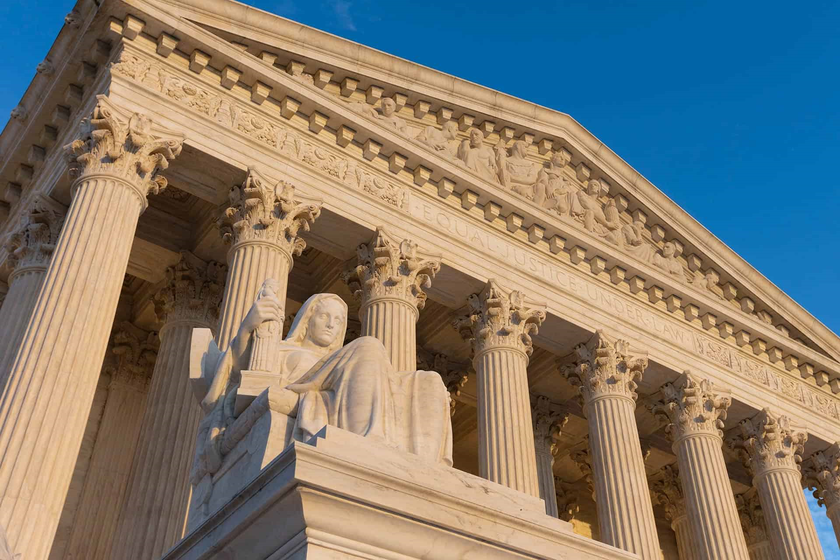
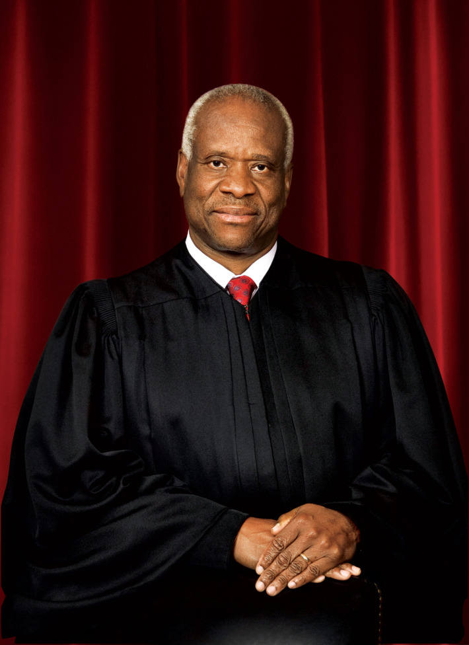
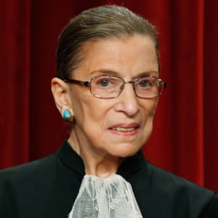
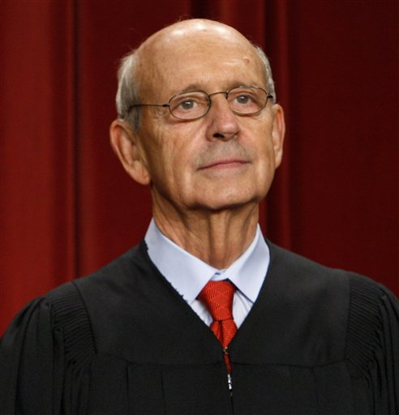
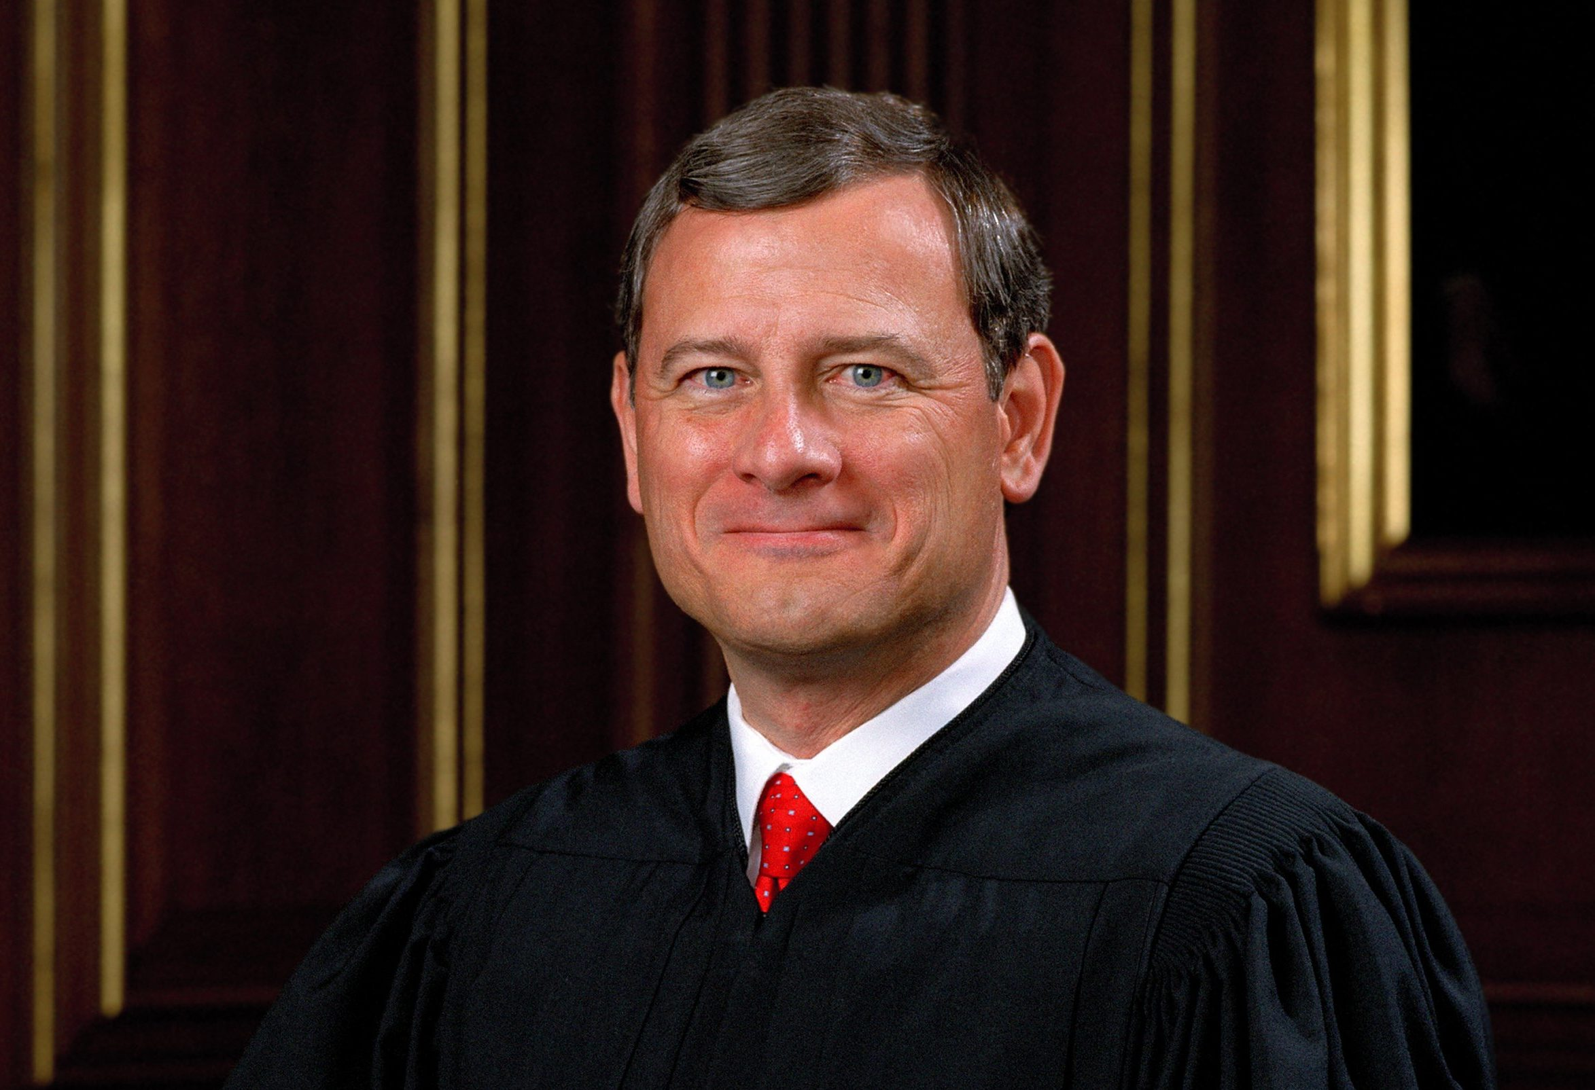
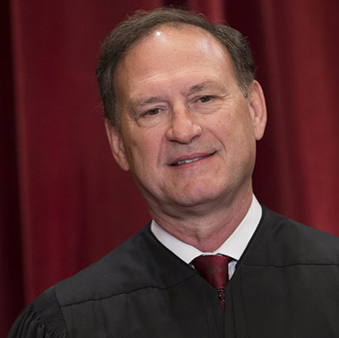
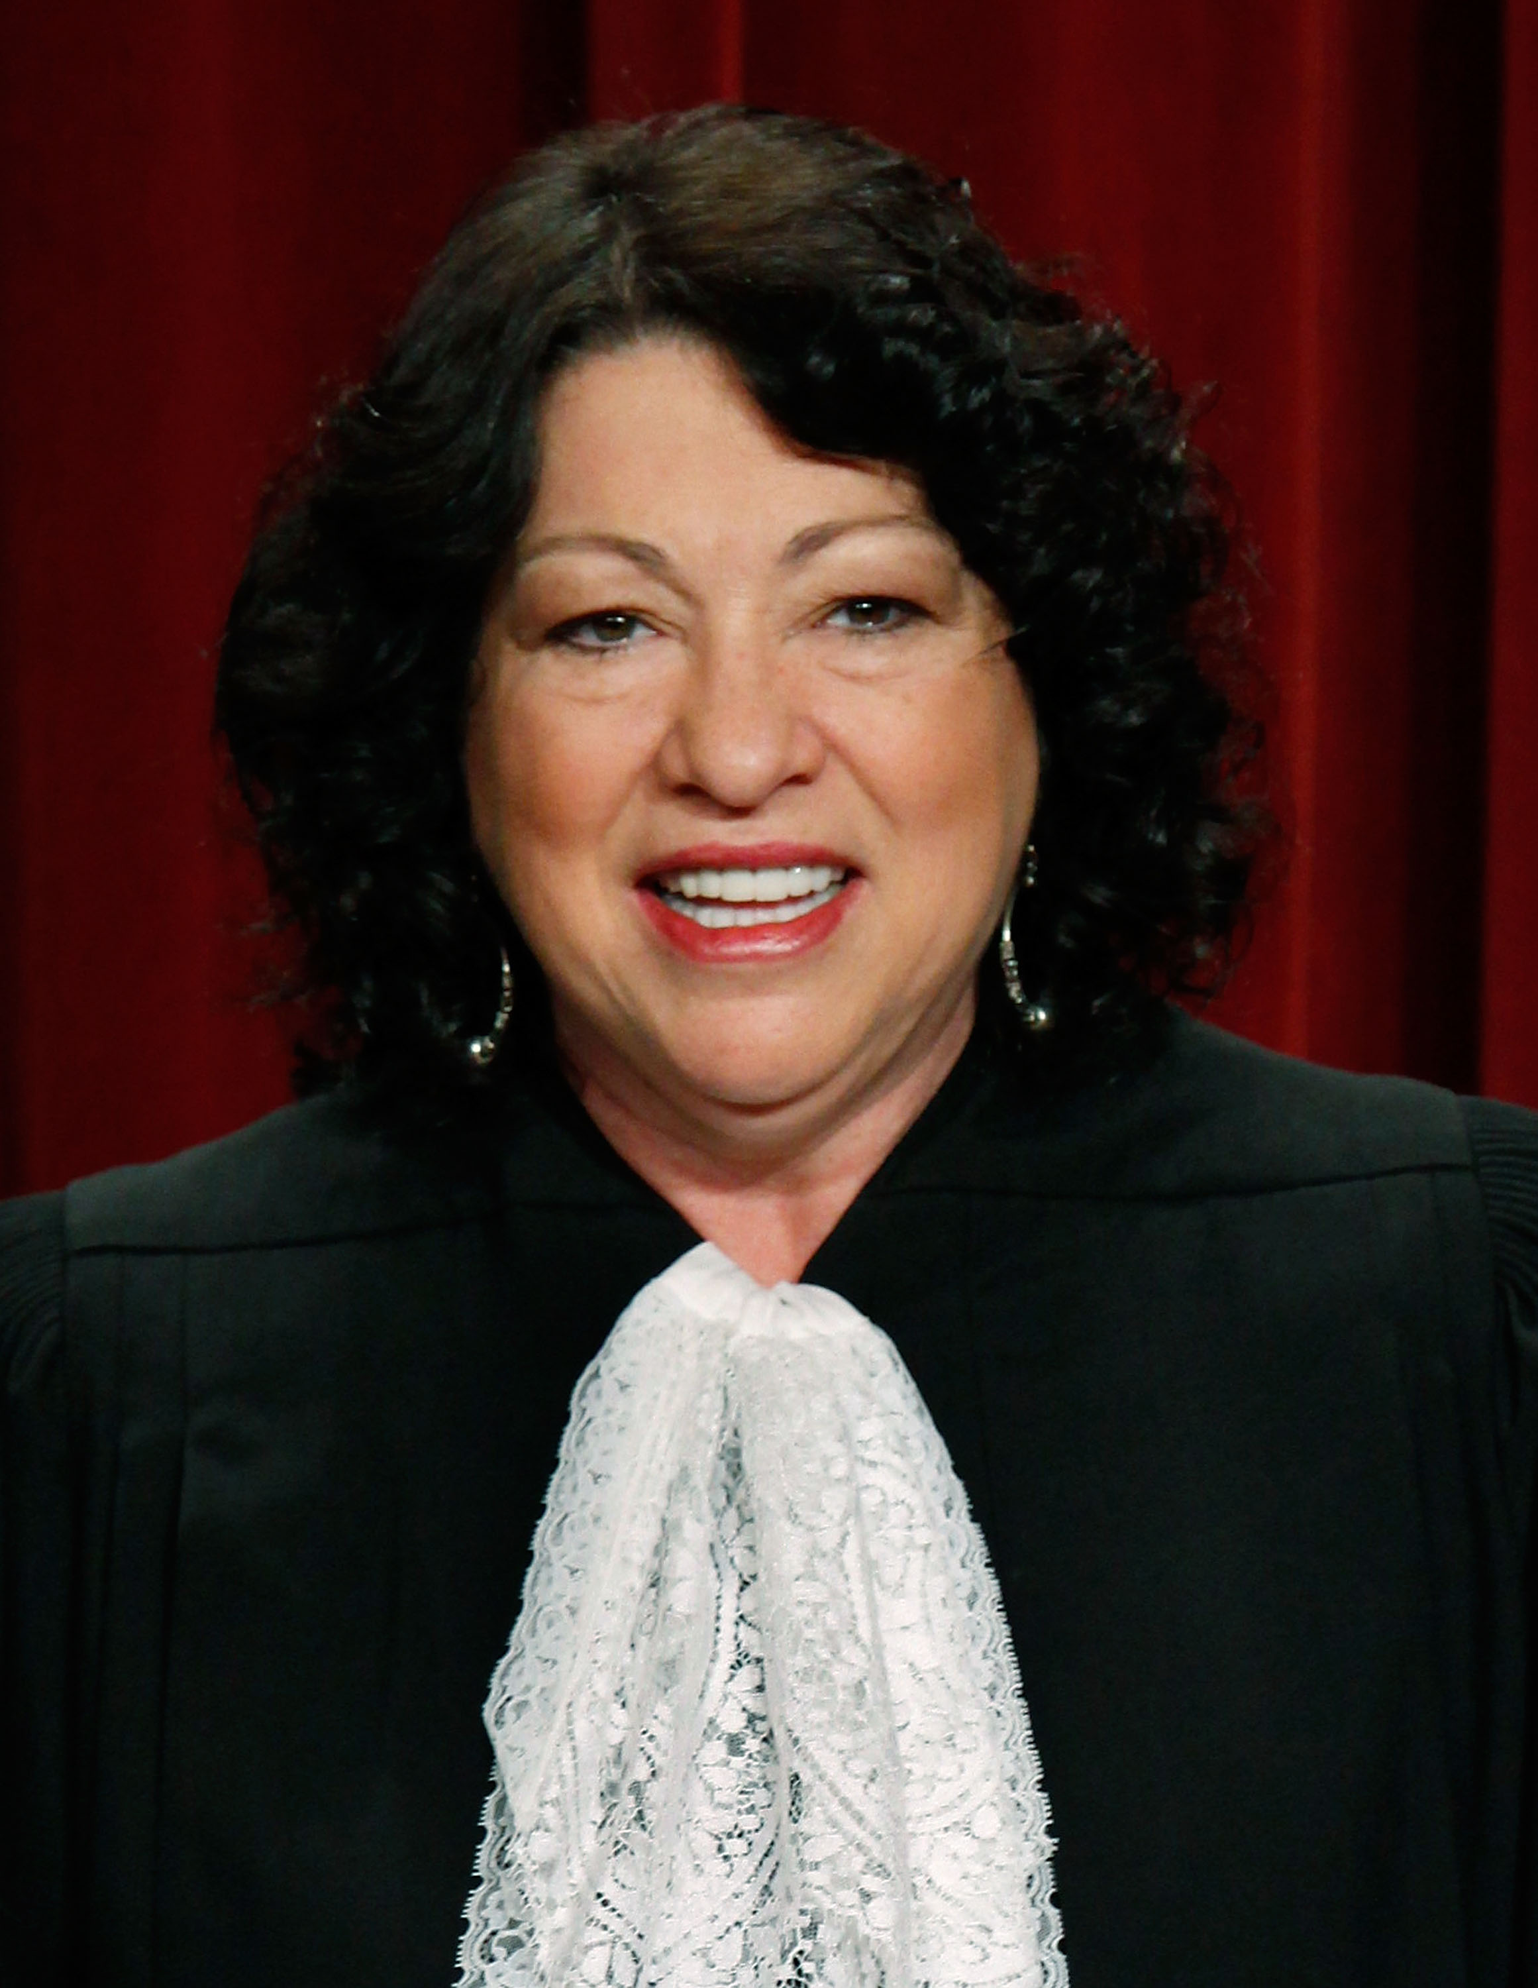
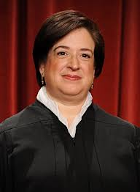
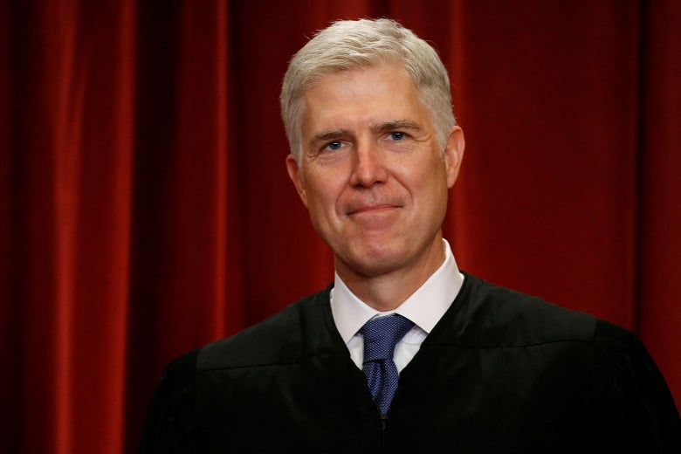
2017 Supreme Court of the United States
Equal justice under law
Justice | Appointed | President Nominated | Constitutional Theory
Thomas | 1991 | George H. W. Bush | Originalist
Ginsburg | 1993 | Bill Clinton | Non-Originalist
Breyer | 1994 | Bill Clinton | Non-Originalist
Roberts | 2005 | George W. Bush | Non-Originalist
Alito | 2005 | George W. Bush | Practical Originalist
Sotomayor | 2009 | Barack Obama | Non-Originalist
Kegan | 2010 | Barack Obama | Non-Originalist
Gorsuch | 2017 | Donald Trump | Originalist

Slide 7
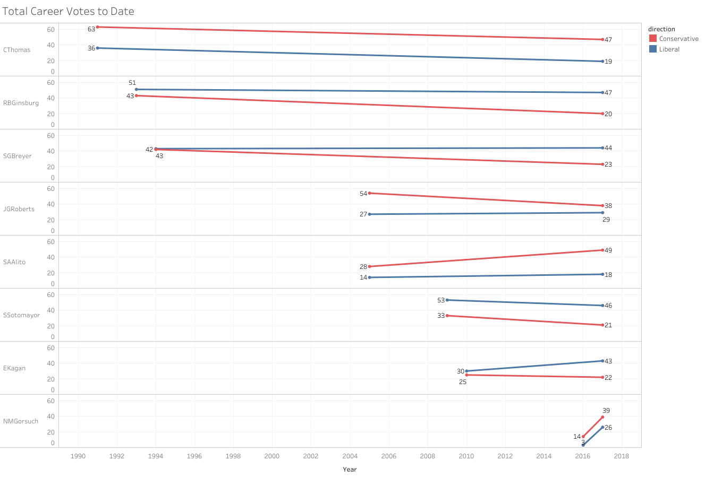
Polarity Over Time
The Justices with the most and least time on the bench (Thomas and Gorsuch respectively) have the least amount of deviation in their vote direction.
Only one Judge (Roberts) has become more centrist during their term.

Slide 8
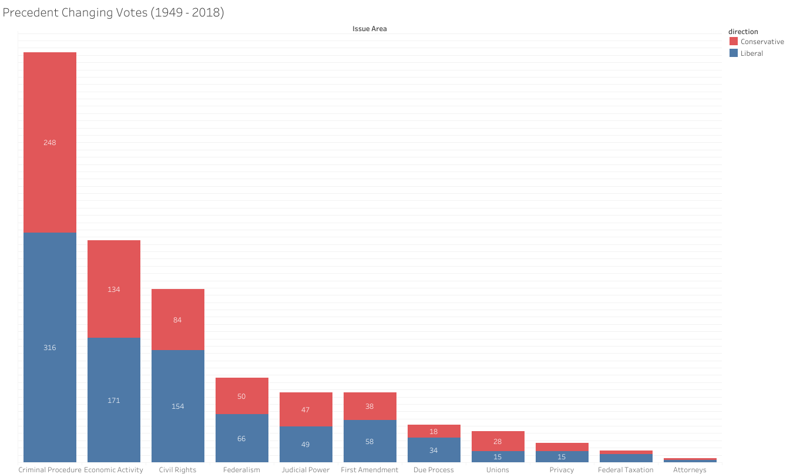
Votes that changed precedents 1949 - 2017

Slide 9
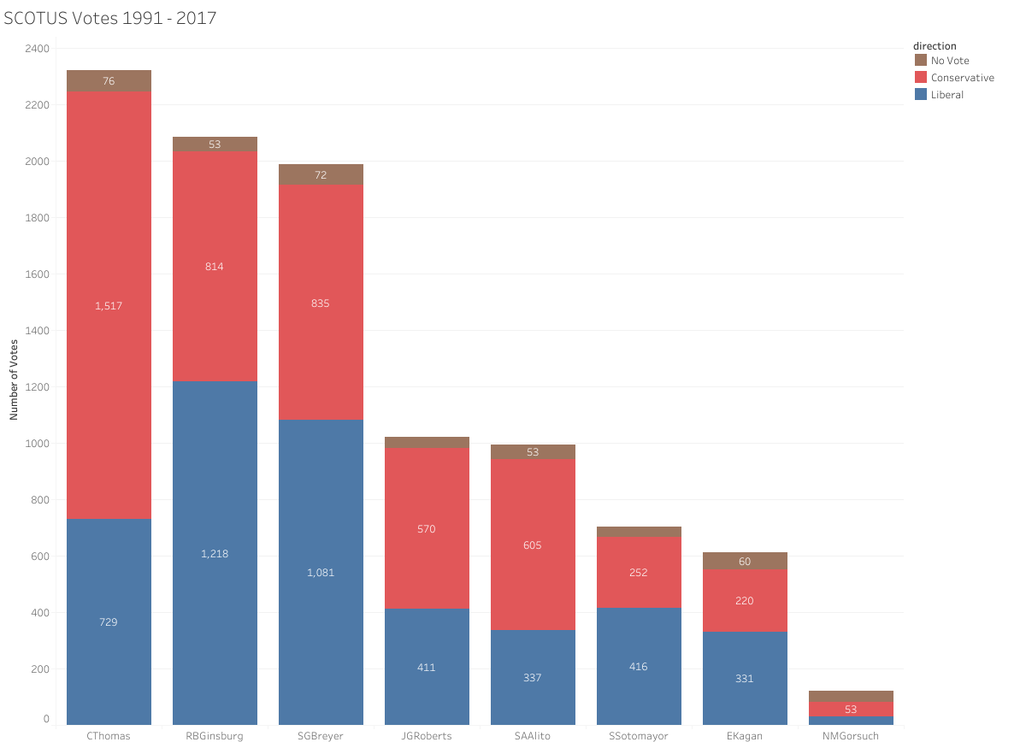
No Vote
Justices may not vote on a case for a number of reasons, but the most common is recusal.
Justice Kagan’s time as the Solicitor General for President Obama’s Justice Department caused her recuse herself from nearly 40 cases between 2005 - 2015.

